Slide 1
PRAGMA27 Expedition Programming Challenge
Report Event
Moderator: Gabriel Zhou
October 17, 2014

Slide 2
Introduction
What is Expedition Programming Challenge?
The expedition programming challenge offers an opportunity for both undergraduate and graduate students(local and visiting), to participate in PRAGMA and work together to solve problems. After two days work, all the participated teams will have an opportunity to present your works and win prize. This event is supported by both PRAGMA community and GLEON community.

Slide 3
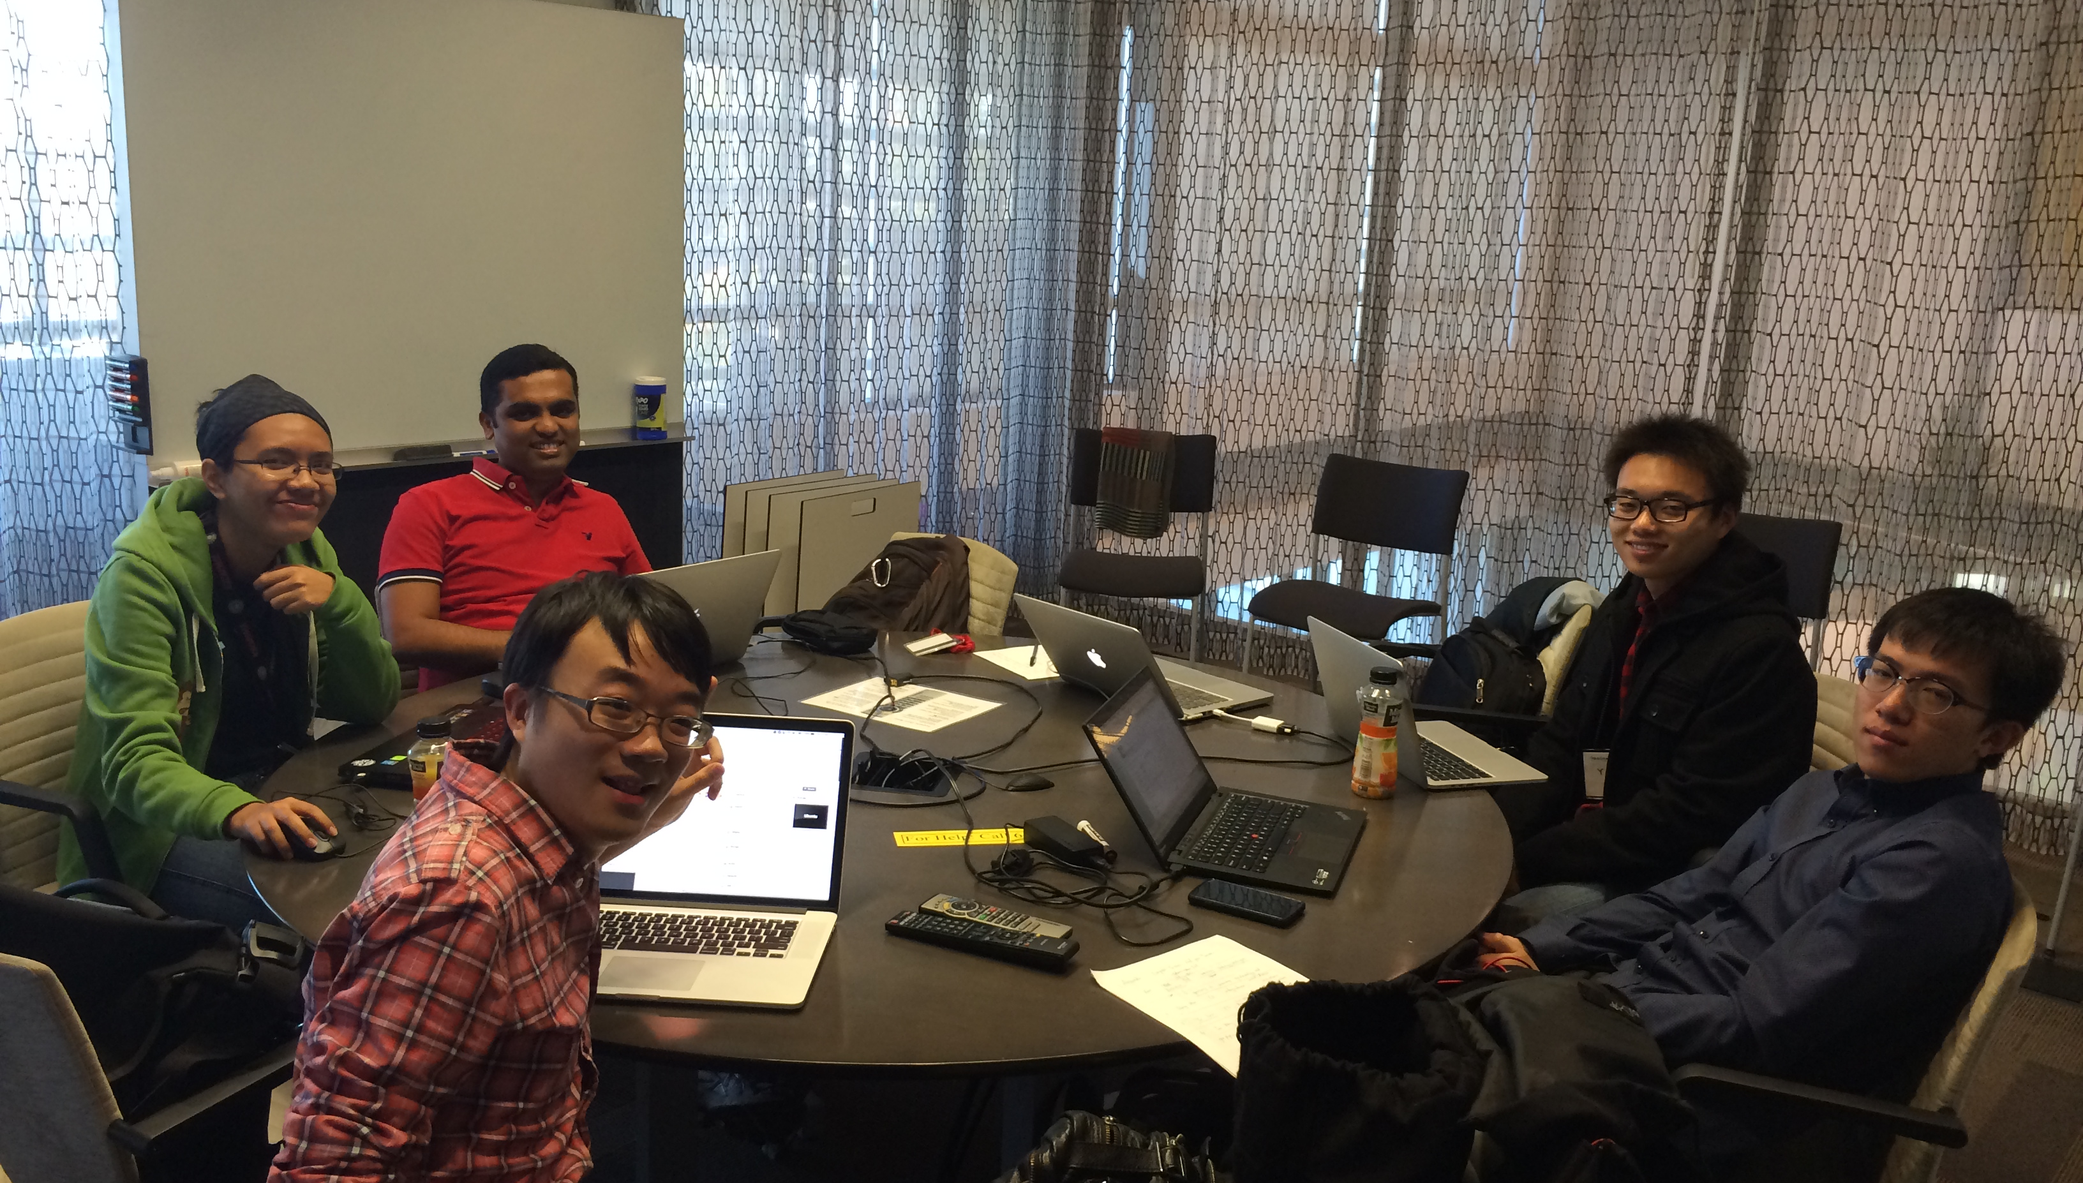

Slide 4
Challenge I: Problem Statement
Use a VirtualBox Rocks Cluster to install and run Lifemapper on your laptop. How?
1) Install VirtualBox on your laptop; 2) You are given a source folder containing virtual images for the cluster (frontend and one compute node) and Lifemapper-server roll. Setup a Virtual Cluster frontend and install Lifemapper components; 3) Bootstrap Lifemapper database; 4) Start the data pipeline for data input initialization; 5) Examine configuration files, install scripts, and logs to identify improvements: a) to the install process; b) to the bootstrap and pipeline verification process. c) Optional: search for methods to set up Lifemapper componenets on Amazon EC2

Slide 5
Presentation & Report
Challenge Case I: Build up LifeMapper Biodiversity Infrastrucuture
-- Aravindh Varadharaju & Ann
-- Hang Zhou
Challenge Case III: Analyze optimization of Lake Buoy Data I/O Overhead
-- Yu Luo
-- Ian Wang & Tony Liu

Slide 6
Challenge II: Problem Statement
Lake Sensor Data QA/QC
DO data sets: dissolved oxygen data collected by a sensor in reservoir- this sensor is deployed for month-long intervals and collects data every 15 minutes at 1m depth.
FCR data sets: 5 temperature files collected by thermistors deployed at five depths (depth in the file name). These sensors were deployed in June 2013 and removed in March 2014, and collect data every five minutes.

Slide 7
Presentation & Report
Challenge Case I: Build up LifeMapper Biodiversity Infrastrucuture
-- Aravindh Varadharaju & Ann
-- Hang Zhou
Challenge Case III: Analyze optimization of Lake Buoy Data I/O Overhead
-- Yu Luo
-- Ian Wang & Tony Liu

Slide 8
Project Hosts
Challenge I: Aimee Stewart, University of Kansas / Nadya Williams, San Diego Supercomputing Center
Challenge II: Craig Snortheim, University of Wisconsin Madison
Challenge III: Jonathan Doubeck, University of Virginia Tech

Slide 9
Organizers
Committee:
Quan(Gabriel) Zhou, Indiana University
Shava Smallen, San Diego Supercomputing Center
Aimee Stewart, University of Kansas
Craig Snortheim, University of Wisconsin-Madison
Yuan Luo, Indiana University
Beth Plale, Indiana University
Acknowledgement:
Cayelan Carey, University of Virginia Tech
Paul Hanson, University of Wisconsin-Madison

Slide 10
For More Information
Our Web Page:http://pragma27.pragma-grid.net/dct/page/70004
Blog.GLEON article: blog.gleon.org/pragma-gleon-expedition-2014/

Slide 11
Thanks!

